Slide 1


Telco Customer Churn
Data Analysis on the Customers' churning behavior of the tele communication Services
Stuti Poudel
Bootcamp: UNC-VIRT-DATA-PT-09-2023-U-LOLC-MWTH
Project 1
Date:- 11/20/2023

Slide 2
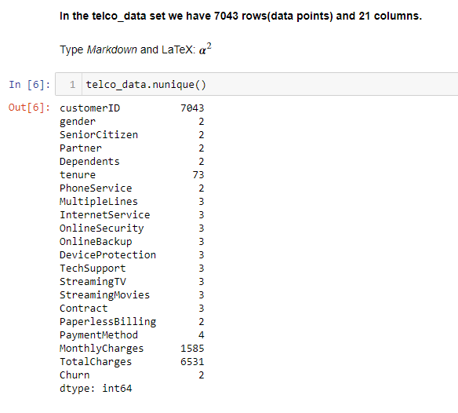
Introduction
This project presents a comprehensive analysis of customer churn within a telecommunications dataset, aiming to discern patterns and indicators that could inform retention strategies.
Here, I have picked 'Monthly Charges' and 'Total Charges' as primary independent factors affecting the churning behavior of customers, which is the dependent variable in this case. In addition, I have also presented a brief breakdown of some of the additional relevant factors, such as Streaming TV availability, Senior Citizen Status, and Categories of Tenure, Contract, and Internet Services in relation to churning variable. In my project, I have used several data visualization techniques and statistical measurements to get a meaningful conclusion.
Chart 1

Slide 3
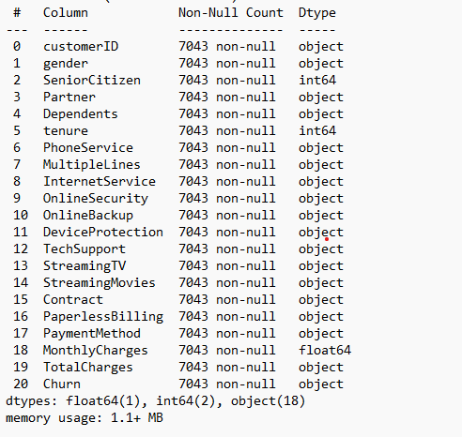
Dataset quick Analysis
In the Telco data set we have 7043 rows(data points) and 21 columns
- We find that Senior Citizen, tenure, and Monthly Charges are the only numerical columns here.
- All other columns, including Total Charges, are listed as string/object data type.
- All other columns, including Total Charges, are listed as string/object data type which we will convert into numerical type (like float) for the proper data analysis.
This clean dataset with no null values, is collected from the GitHub page. The link is here posted: https://www.kaggle.com/datasets/blastchar/telco-customer-churn.
Chart 2

Slide 4
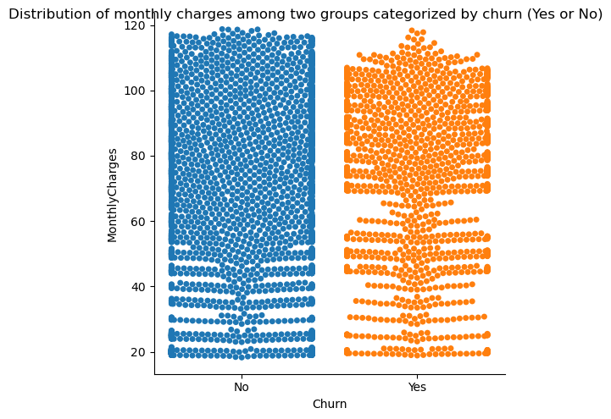
Exploratory Data Analysis
Monthly charges
Distribution of monthly charges among two groups categorized by churn (Yes or No)
No (Didn’t Churn)
Yes (Churn)
The Yes' category (customers who have churned) is more spread out, with a significant portion of data points at the higher end of the monthly charges. The 'Yes' churn group has a broader distribution, indicating a wider variation of monthly charges among churned customers and possibly a correlation between higher charges and the likelihood of churn.
The 'No' churn group shows a high density of points tightly distributed approximately in the 50−110 range, indicating that most customers who did not churn pay a monthly charge within that range. This implies a potential threshold range for monthly charges that could be associated with customer retention.
Fig 1.
Based on the bee swarm plots above, we can see that both categories have a substantial number of data points, indicating variability in monthly charges among both categories of customers.

Slide 5
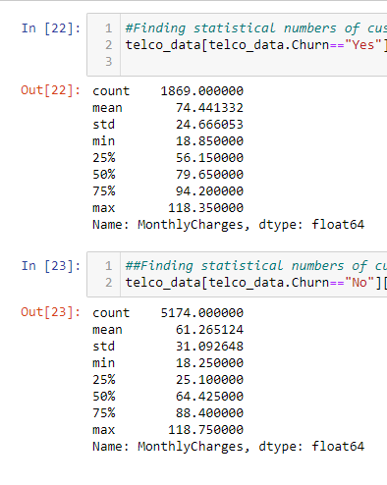
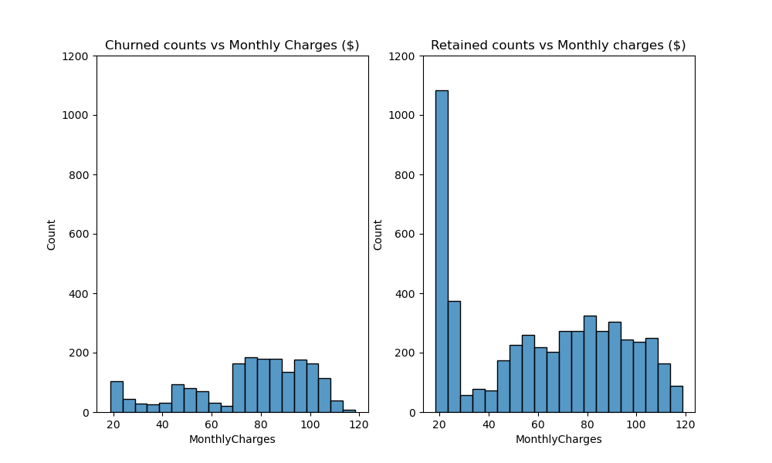
Monthly charges (continued)
The distribution of monthly charges for churned customers is shifted towards higher values than retained customers.
The difference between the mean monthly charges for the two groups, (churned)$74.44 > $61.27(Retained) also suggests that. This indicates churned customers tend to have higher monthly charges on average.
Most customers who churned have the monthly charges between approx. $ 70-$ 80, whereas most retained customers are between the monthly charges of $ 15-$ 30 which we can see by the tallest bar in the second chart.
chart 3.
Fig 2.
In summary, we can say that churned customers tend to have higher monthly charges on average than retained customers, which makes sense as many customers may have preferred the lower monthly charges and decided to retain their service, and as the monthly charges rate goes higher, retention rate also significantly fell suggesting less customers are being retained at higher monthly charges.

Slide 6
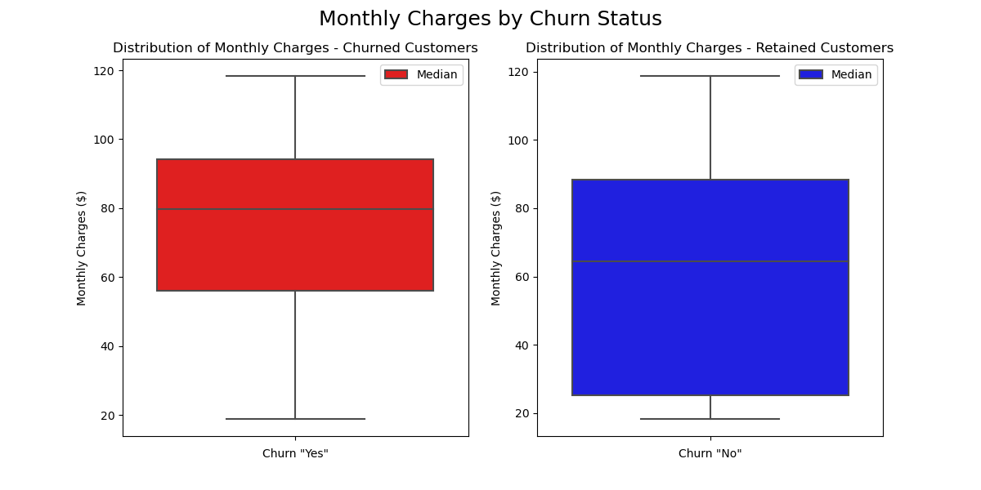
Monthly charges
Monthly charges (continued)
Analysis
The median monthly charge is higher for churned customers ($79.65) than retained customers ($64.43). This reinforces the idea that higher monthly costs are associated with increased churn risk and also suggests that lower monthly charges could be associated with customer retention.
Also, there are no evident outliers in both groups, churned and retained customers, which suggests that both churned and retained customers' monthly charges are relatively consistent within the observed range.
In summary, The IQR for retained customers is greater than the IQR for churned customers, indicating more variability in the monthly charges for retained customers compared to churned customers.
- In summary, more variability in the monthly charges of retained customers suggests regarding pricing flexibility and customization helps retain customers across diverse price points and tolerance levels
fig 3.

Slide 7
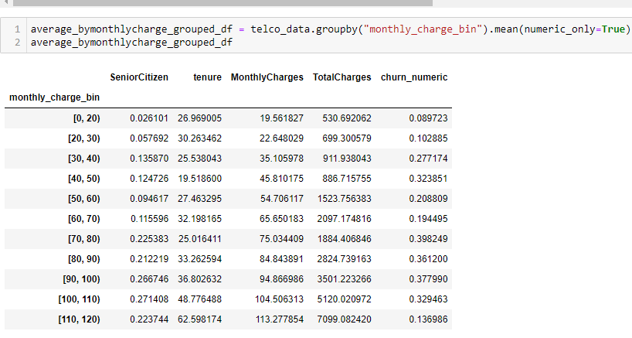
Monthly charges (continued)
- The churn rate is lowest at $ <20 bin which is only 8.97 %.
- Our fig2. at slide # 5 also pointed us that customers who are in the monthly charge bin of around $20 (most affordable service) have the highest retention rate.
- The average monthly spending customers, which falls in the range of $70 - $100, have churned the most, while low and high-spending customers have churned less.
- There is also a notably lower churn rate in the $110 - $ 120 range.
- This lesser churn rate at the highest monthly bin could be due to perceived higher value or satisfaction with the service they are receiving,
- Higher charges could be associated with premium or bundled services, hefty cancellation fees, or better or more personalized customer service; there might be fewer competitive options available for the specific services these customers are using, resulting in lower churn due to a lack of better alternatives.
Creating bins in Monthly charges
Chart 3.

Slide 8
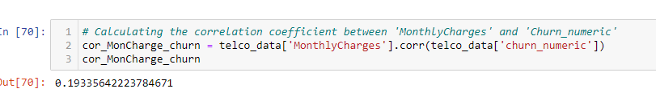
Monthly charges and Churn rate
The correlation coefficient of approximately 0.193 indicates a weak positive linear relationship between the two variables. This suggests that as monthly charges increase, there is a slightly higher likelihood of churn, although the relationship is not strong.
fig 5.

Slide 9
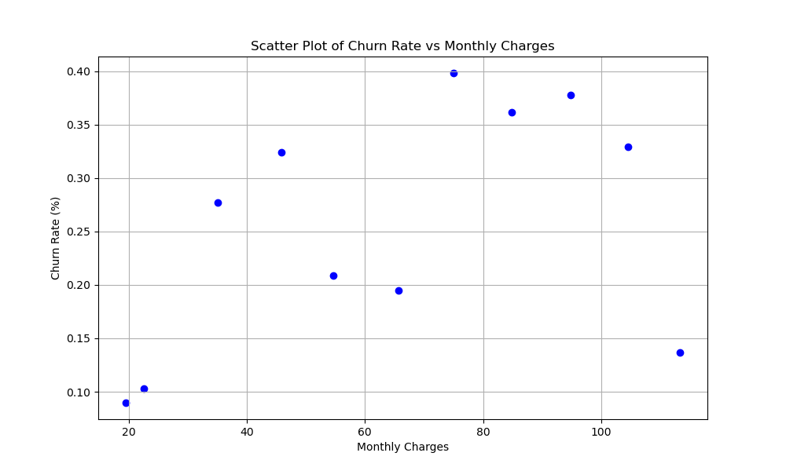
Monthly charges (continued)
Monthly charges and Churn rate
fig 4.

Slide 10
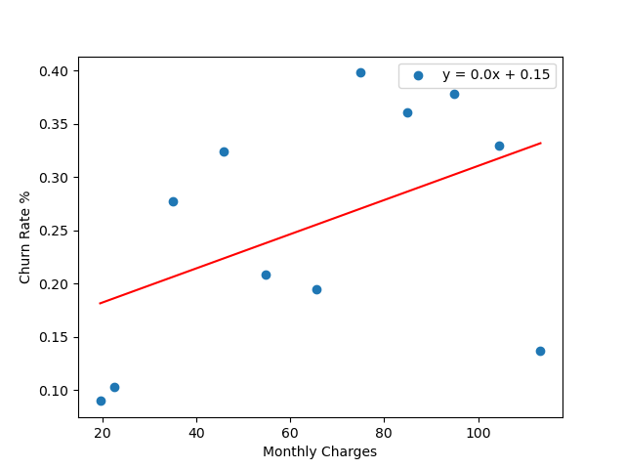
Monthly charges (continued)
Monthly charges and Churn rate
The R-squared value of (approx.) 0.212 from the scatter plot and linear regression analysis indicates a moderate positive relationship.
- As the monthly charges increase, the churn rate also tends to increase, suggesting higher prices may lead to higher churn. However, The linear regression model explains only about 21% of the variance in churn rate. This indicates that monthly charges are a factor in churn but not the only or most significant one.
- The other 78.8% of the variation is due to other factors.
fig 5.

Slide 11
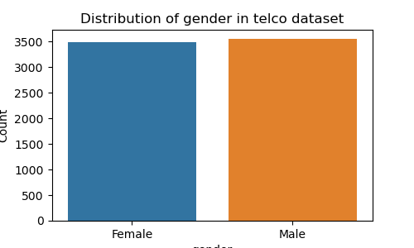
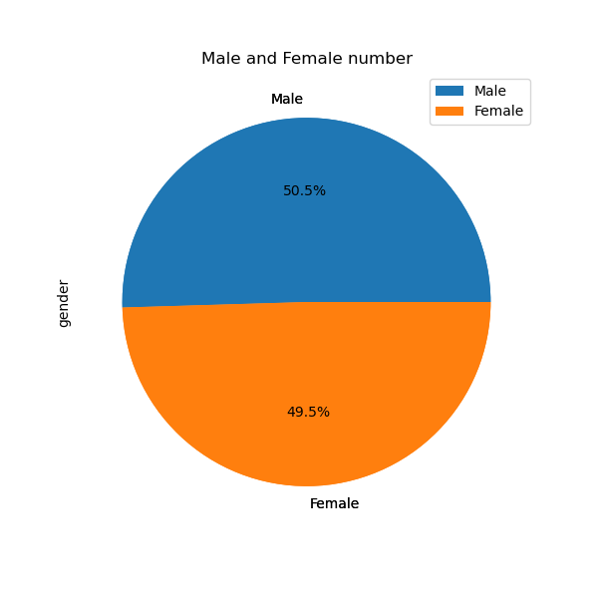
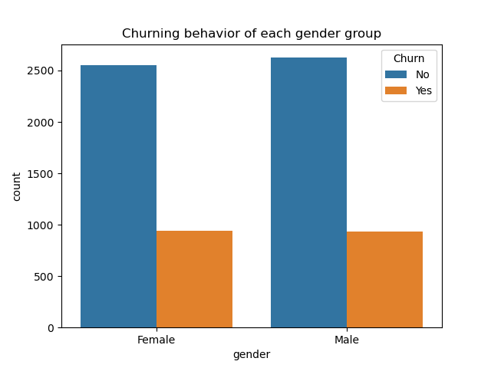
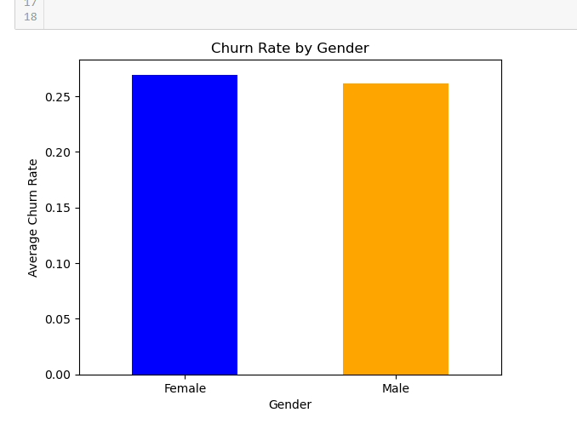
Analysis
Gender
Fig6.
Fig7.
Fig8.
- We found that the churn rate for females and males is 27% and 26%, respectively, suggesting that the churn rate for both genders is almost identical.
- Gender might not be a strong standalone predictor of churn in this instance, given the rate similarity.
Fig 9.

Slide 12
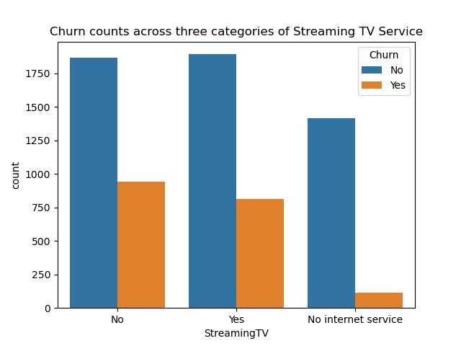
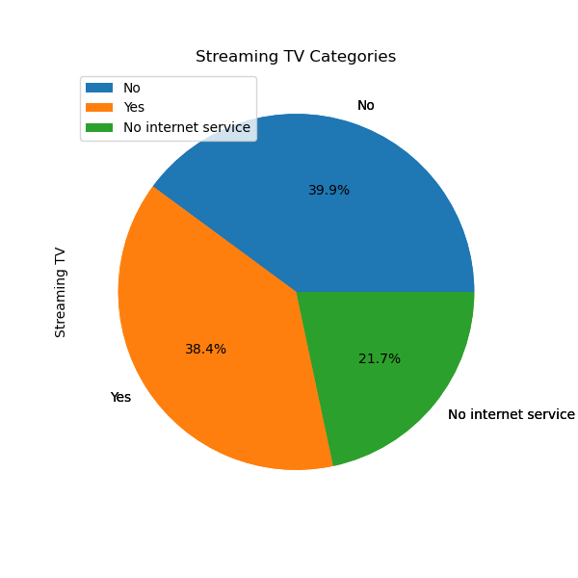
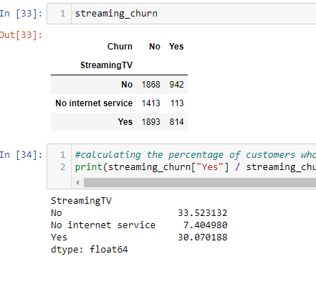
Analysis
Streaming TV Categories
Fig 10.
Fig 11.
- People who have ‘Streaming TV services’ and those who don’t have ‘Streaming TV Services’ are almost identical in numbers, they are, 38.4% and 39.9% for both respective categories.
- The churning rate is only 33.52 % for customers without Streaming TV and 30% for customers with Streaming TV.
-Likewise, 21.7 % out of all people without internet service, very few of them churned (113 out of 1526), i.e., 7.40%, suggesting these customers with no internet service may be using the telecommunication services for phone lines only.
Chart 4.

Slide 13
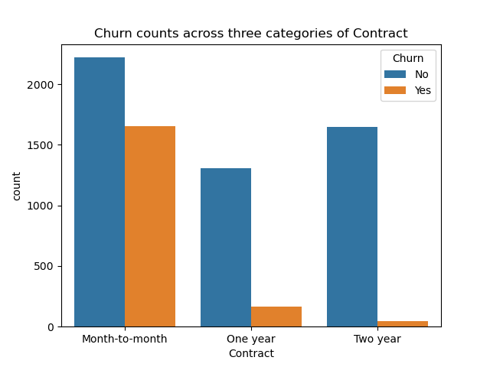
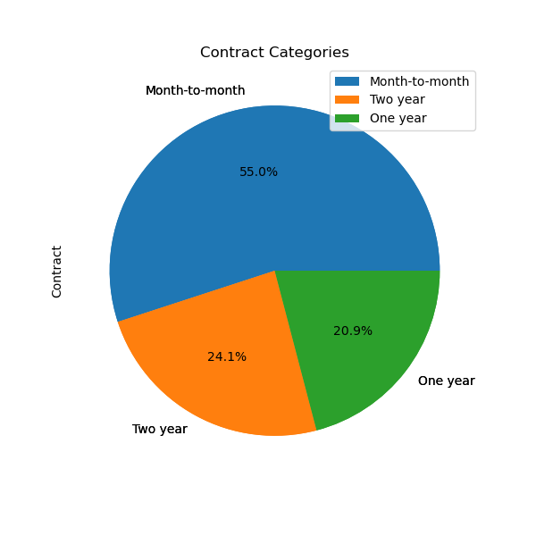
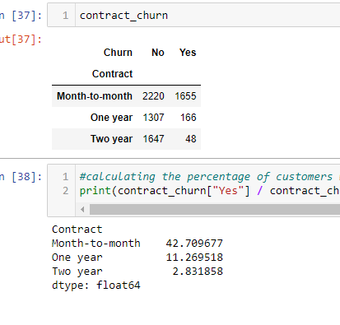
Analysis
Contract Categories
Fig 12.
Fig 13.
- Customers with a month-to-month contract have the highest churn rate.
- Approximately 42.71% of customers with a month-to-month contract have churned. Whereas customers with more extended contracts (one year and two years) have significantly lower churn rates, with the two-year contract holders being the least likely to churn(2.83%).
- Highest month-to-month churn rate could reflect a commitment level or satisfaction with the service.
- Other reasons why the month-to-month contract has the highest churn could be, such as unaffordability of services for a more extended period, end of promotions and trial periods, life changes, etc.
Chart 5.

Slide 14
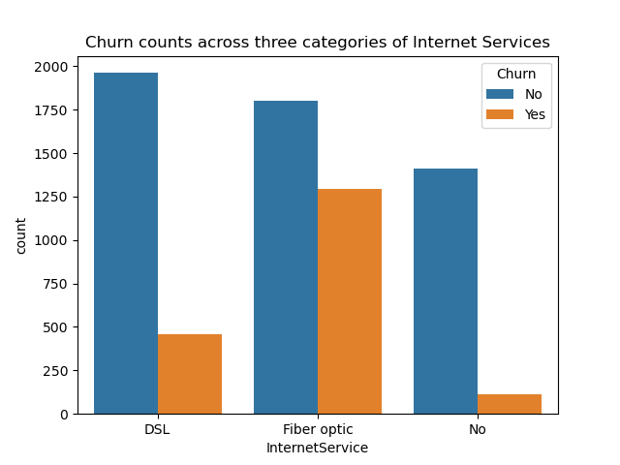
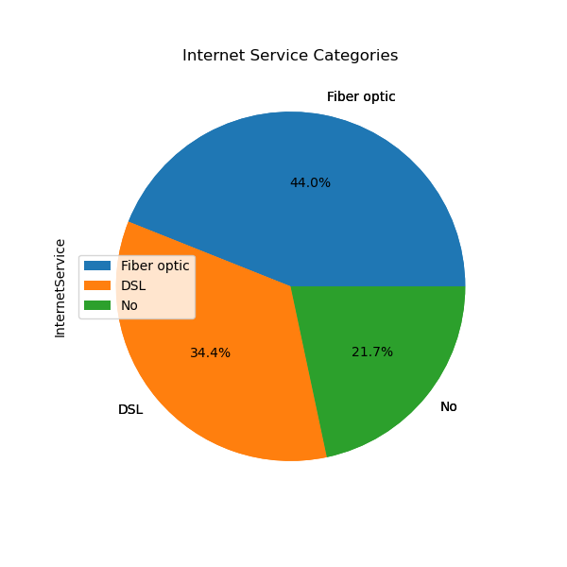
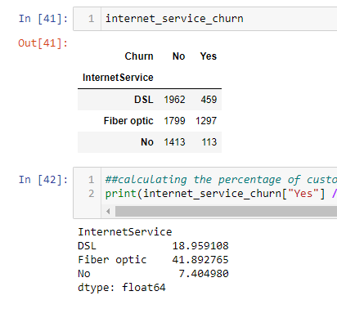
Analysis
Internet Service Categories
Fig 14.
Fig 15.
- Fiber Optic has the highest churn rate, i.e., 42%, which is 1297 counts of churns out of 3096 total Fiber Optic customers.
- Customers with No internet service have the lowest churn rate at only 7%, which is 113 counts of churns out of 1526 customers with no internet service
This suggests issues around fiber optic services driving churn or customers getting fiber, expecting faster speeds but being disappointed. The provider could improve fiber optic performance and customer satisfaction to reduce churn.
Overall, internet service type seems correlated with the likelihood of churn. Improving fiber optic satisfaction and analyzing the root causes of dissatisfaction among fiber optic customers could reveal ways to improve retention.
Chart 6.

Slide 15
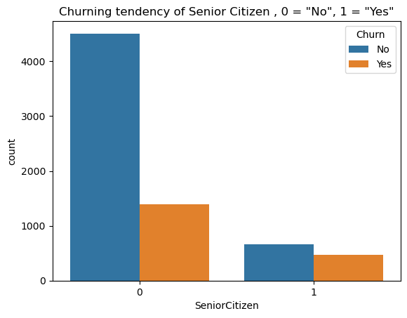
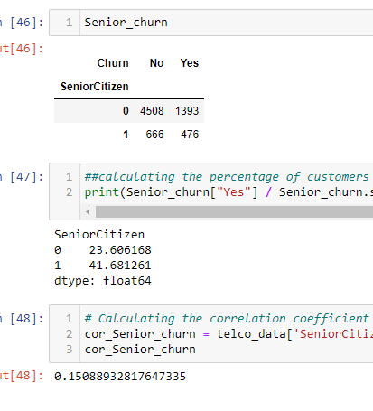
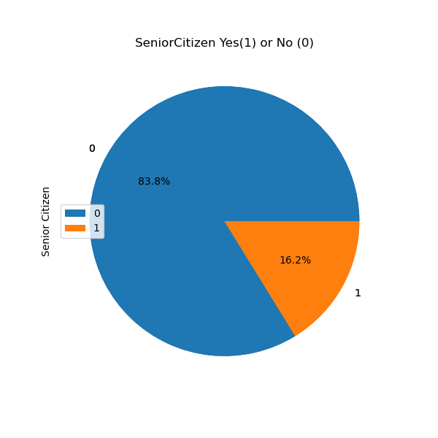
Analysis
Senior Citizen status
Fig 17.
Fig 16.
chart 7.
- Non-seniors (under 65 years old) are in lot more counts in the churning side of the dataset, however; Senior citizens (65+ years old) are notably churning at a higher rate (41.68%) than non-senior citizens (23.61%). The churn rate is almost double for senior citizens versus non-seniors even though seniors are only 16.2% of the total customers in the dataset.
- The smaller number of senior citizens in the dataset could mean we didn’t collect enough data from the senior citizen population, while their higher churning rate suggests that they may need additional retention efforts, special offers, or customized service to reduce their churn rate.
- However, the value of (approx.) 0.15 of the correlation coefficient indicates a weak but positive correlation between being a senior citizen and churning, suggesting that there are other factors that may be more responsible for the customers' churning behavior.
-

Slide 16
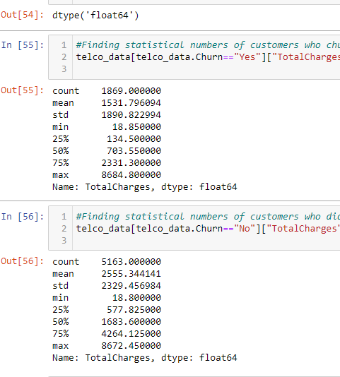
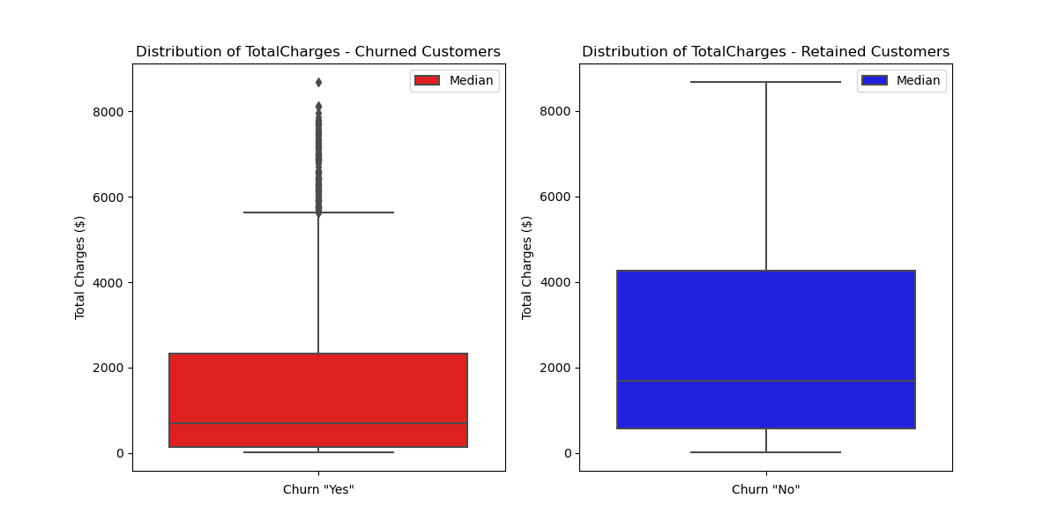
Analysis
Total Charges
Fig 18.
Chart 8.
- The median total charges for Churned customers are lower than retained customers ( 703.55 < 1683.60).
- The interquartile range (IQR), represented by the length of the boxes, seems to be wider for retained customers, suggesting more variability in the total charges among customers who have not churned, which is also the case with monthly charges as shown in slide 6 (fig3.)
Also, there are a significant number of outliers among churned customers, suggesting that while the median total charge is lower, several churned customers still had very high total charges(extreme values). The absence of outliers in the retained customer box plot suggests a more uniform distribution of total charges without extreme values.
The more consistent range of total charges among retained customers could indicate that customers within a specific range of spending are more likely to stay, which could be a sign of stable usage patterns and satisfaction with the service among these customers, possibly because they find the services to be of good value or due to the costs associated with switching to another provider.

Slide 17
Conclusion
With respect to "Monthly charges": There could be other factors influencing churn that are not included in the model. These might include customer service quality, contract terms, competitive offers, individual customer preferences, and market conditions. The dataset might not represent the broader population or capture enough historical context to adequately model the churn behavior regarding monthly charges’ relationship with the churn rate. While the R-squared value indicates the strength of the relationship, it would also be essential to consider the p-value associated with the regression analysis to understand whether the observed relationship is statistically significant.
With respect to “Internet Services” Categories: One relevant factor here that may be affecting the churn rate is Fiber Optic, which has the highest churn rate, i.e., 42%. This rate suggests issues around fiber optic services driving churn or customers getting fiber, expecting faster speeds but being disappointed. The provider could focus on improving fiber optic performance and customer satisfaction to reduce the high churn. Overall, internet service type seems correlated with the likelihood of churn. Improving fiber optic satisfaction and analyzing the root causes of dissatisfaction among fiber optic customers could reveal ways to improve retention.
With respect to “Contract” categories: Another variable that is a notably decisive factor here is the month-to-month contract. Our analysis above shows that the month-to-month contract has the highest churn rate. Approximately 42.71% of customers with a month-to-month contract have churned. Whereas customers with more extended contracts (one year and two years) have significantly lower churn rates, with the two-year contract holders being the least likely to churn(2.83%). The highest month-to-month churn rate could reflect the lowest commitment level or satisfaction with the service. Other reasons why the month-to-month contract has the highest churn could be the unaffordability of services for a more extended period, end of promotions and trial periods, life changes, etc.
With respect to “Total Charges:” The significant presence of outliers among churned customers suggests that while the median total charge is lower, several churned customers still have very high total charges. The absence of outliers in the retained customer box plot suggests a more uniform distribution of total charges without extreme values. Since churned customers have a more comprehensive range of total charges with outliers indicating some high values, the business might want to investigate why customers with high total charges are leaving and address those reasons to improve retention. The more consistent range of total charges among retained customers could indicate that customers within a specific range of spending are more likely to stay, which could be a sign of stable usage patterns and satisfaction with the service among these customers, possibly because they find the services to be of good value or due to the costs associated with switching to another provider or lack of a better alternative.
With Respect to “Senior Citizen”: The churn rate is almost double for senior citizens versus non-seniors (41.68% >23.60%) even though seniors are only 16.2% of the total customers in the dataset. The smaller number of senior citizens in the dataset could mean we didn’t collect enough data from the senior citizen population. At the same time, their higher churning rate suggests that they may need additional retention efforts, special offers, or customized services to reduce their churn rate.
In conclusion, different variables undoubtedly have marginal effects on our variable “Churn.” However, it is crucial to acknowledge that the interactions between these variables can influence churn in reality.

Slide 18
Questions?

Slide 19

Thank you!
Stuti Poudel​
XXX-XXX-XXXX
Stuti.poudel@outlook.com

